Slide 1

CS689 Module 3-Extract, Transform, Load
MET CS 689
Designing and Implementing
a Data Warehouse
Jack Polnar
10/21/2023

Slide 2
Agenda
ETL Overview
Extracting Data Sources
Loading Staging Data
Transforming Data
Loading Data
Loading SCDs and Facts
Maintaining Loads and Error handling

Slide 3
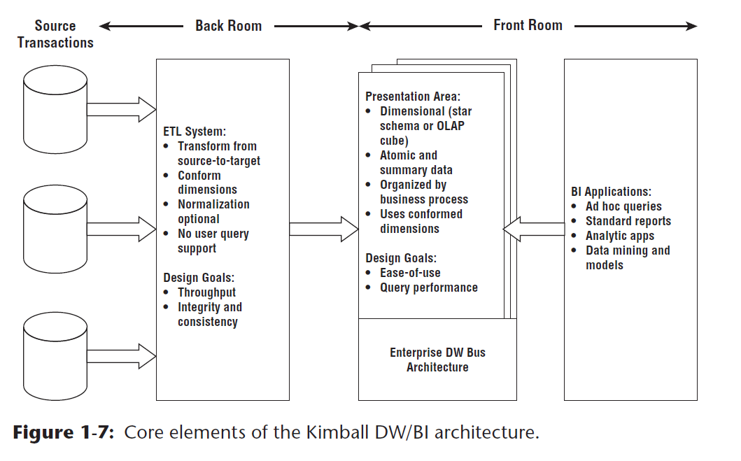
Kimball’s BI architecture

Slide 4
Extract, Transform, Load
Extract: Pull data from different source systems (internal and/or external).
OLTP databases, spread sheets, log files.
Transform: Makes data consistent for analysis.
“Scrub” /data-wrangle data using different techniques, rules, functions, and calculations.
Transform into summations, calculations, splitting & merging data.
Load: A single unified data set for analysis.
Insert the scrubbed & transformed data into a DSS schema.

Slide 5
Review DW Implementation Process
Implement the design
Data Lakes, ODS/Staging tables and Dimensional Model
Data Movement (E- from ETL)
Extracting data from one or multiple sources
Load into data lake/ODS/Staging/Landing
Scrubbing/wrangling the data
Preprocess/Transform into dimensional model (TL from ETL)
Grains, measures/aggregates
Testing/Quality - Identify and validate errors and anomalies, and re-process ETL
Load into final schema
Data Presentation
Semantic layers - views
Dashboards, Reports on top of the dimensional model.

Slide 6
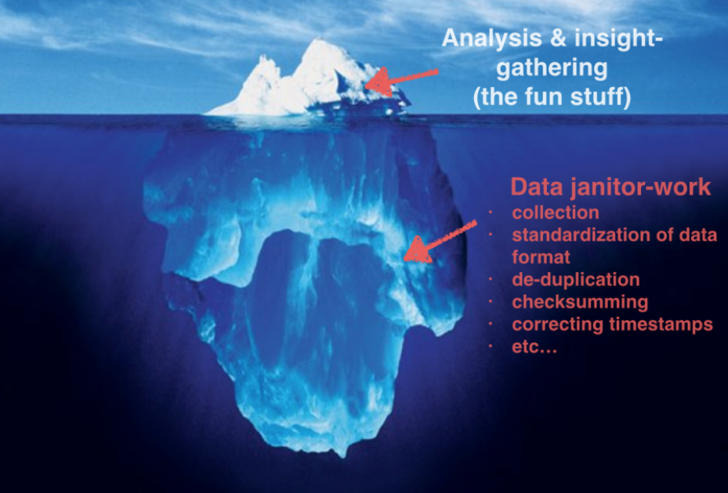
ETL Challenge
Per Kimball/Ross ETL process “consumes a disproportionate share of the time and effort required to build [and maintain] a DW/BI environment.”
https://amplitude.com/blog/big-data-cleanup

Slide 7
Scrub, Rinse, Repeat
Large/complex initial load of historical information and process setup
However- ETL is a repeating, ongoing process
Management: A regular re-capture of data and update or refresh of data warehouse
Not part of ETL acronym however just as important.
Automation must be reliable – can’t hard code for single instance of the ETL
Consistency is very important

Slide 8

ETL or ELT
Traditional ETL approach
Extract from source into staging tables/landing area
Transform
Load into warehouse
Another approach
Extract from source
Load
Data lake or directly target DW tables
Transform
Some transformed data may be loaded into a formal data warehouse, or analytical database
In reality “E”+”T”+”L” is potentially a multi step process

Slide 9
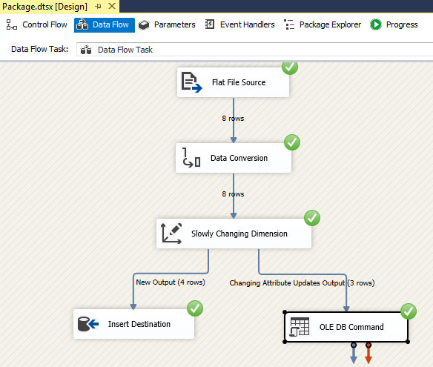
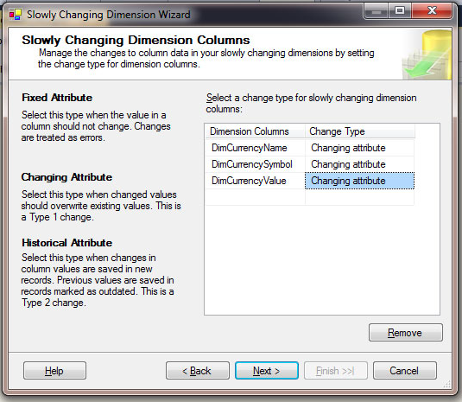
“Off the Shelf” ETL Alternative
Don’t re-invent the wheel
Instead of implementing mapping, transformation via Python or SQL – use an existing tool
Many options such as, SQL Server SSIS, Informatica, Goldengate, DataStage as well as open-source tools
Wide connectivity to data sources and destinations
However
Not a silver bullet – tools are somewhat limited to more complex transformations.
Extensive analysis of existing data and intended use must still be done.
https://www.learnmsbitutorials.net/slowly-changing-dimensions-ssis.php

Slide 10
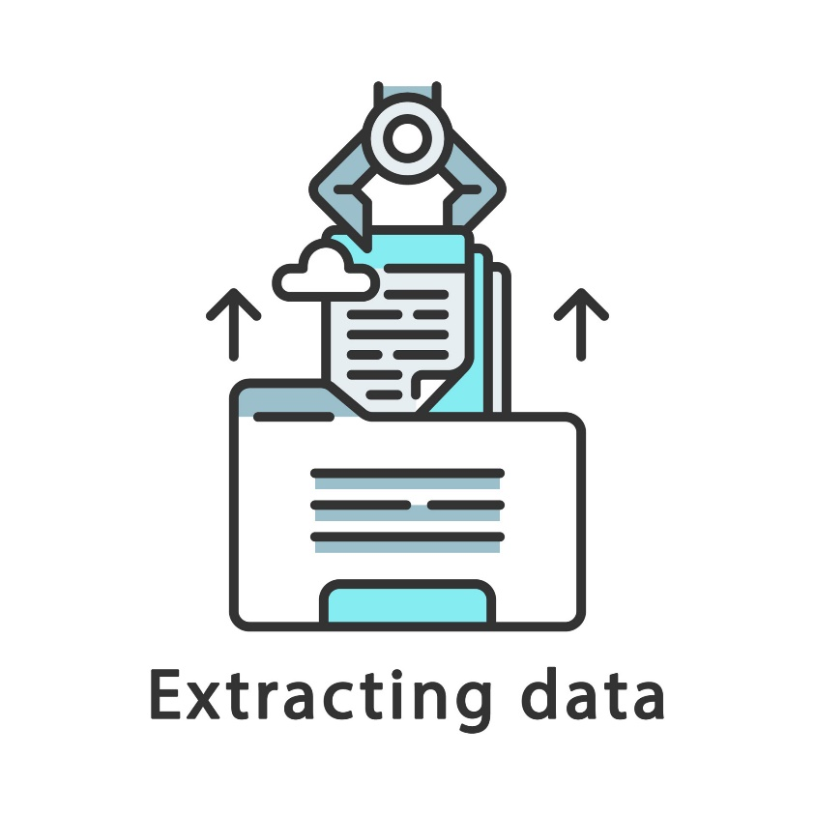
Extraction – Data sources
Operational Data Stores
Data Feeds
Flat files
Documents (XML & JSON)
Web Services & APIs
Streaming Data

Slide 11
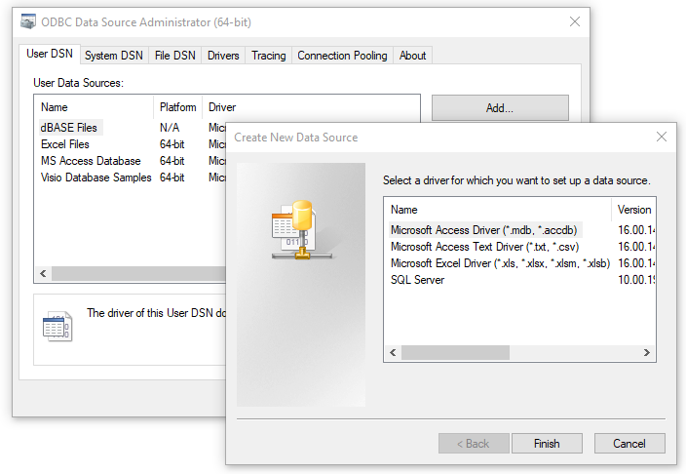

(Remote) Operational Data Stores
Extracting data from Relational Structured MOSTLY CONSISTENT OLTP system
Huge advantage in that the data is mostly consistent and clean
Connections via ODBC (Open Database Connectivity)
Extraction typically via a series of SQL queries
Will require some joins, however the benefit will be consistent data
Look to use Views
Reference tables
Can be impaired by RDBMS concerns
Performance issues-lock contention on heavy queries
What if the structure changes?
I can make your ETL very simple!

Slide 12

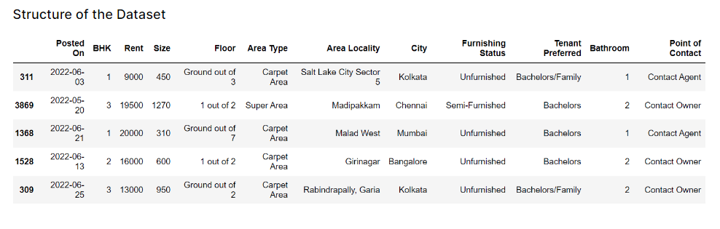
Data Feeds- Flat File Sources
“Flat files” –comma-separated (CSV), tab, pipe “|” excel, etc.
How are Flat Files generated from source?
Data extracted from source operational DB (i.e. SQL query that creates an output)
Excel/Google Sheets
Log files
Surveys
Flat file data does have structure – data is atomic
Usually first row identifies the attributes (not data types)
Common to have highly duplicated, non-1NF data
Automation via SFTP (Secure File Transfer Protocol)
Flat files just work – when attributes have structure….
https://www.kaggle.com/datasets/iamsouravbanerjee/house-rent-prediction-dataset?select=Dataset+Glossary.txt

Slide 13
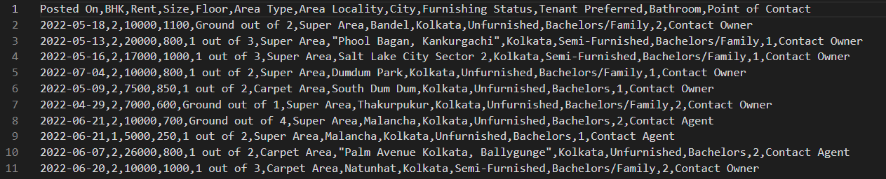
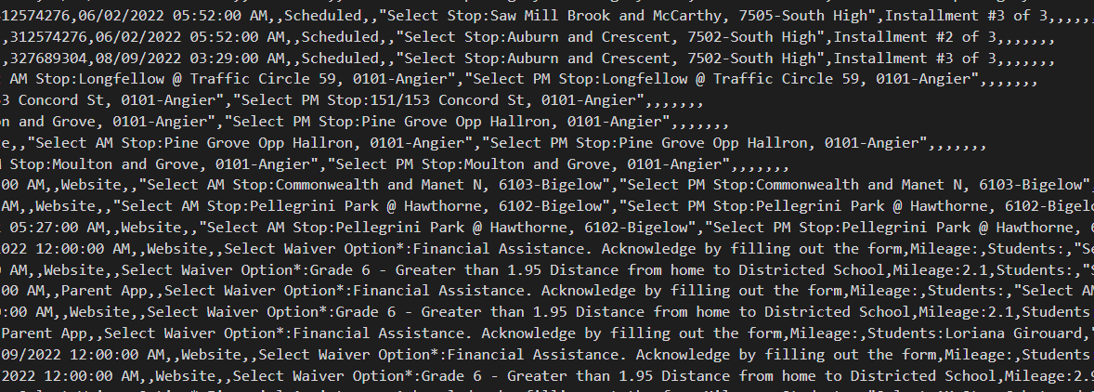
Flat File Example
Kaggle makes it nice.. Too nice! The data sets are usually pre-scrubbed
How about a real example? – Yes- I have some interesting data ingestion at my work!
Tip – open data in text editor (Visual Studio Code, Notebook++) not excel to see what the data really looks like – especially dates, numbers, etc)

Slide 14

Flat File Sources Challenges
Data Types
Dates
Example of converting a string date to current date in MySQL: STR_TO_DATE(CURRENT_DATE),'%m/%d/%Y')
Integers, Numeric types…
Common to have highly duplicated, non-1NF data
contains many NULL values for attributes that do not have a value for an attribute
Data may have anomalies – depending on the original extraction
Unstructured strings – welcome to string parsing !@!G@#D!!
Variation in data and structure!

Slide 15
Semi-Structured Data feeds
When structure changes…
XML and JSON can provide FLEXIBILITY!
XML/JASON is a text-based meta-language
– Provides semantics (defining flexible structure – self describing)
Data Exchange- Application Programming Interfaces (API)
An XML document is organized as a tree data structure
single named node at the top
hierarchy of named nodes beneath it
An XML document may refer to a Document Type Definition (DTD) or XML Schema Document (XSD) document that defines the valid tags and the relationships between the data elements.
Web Services/APIs (Application Programming Interfaces)
Extraction program ”reaches out” to known locations/URLs and issues requests

Slide 16
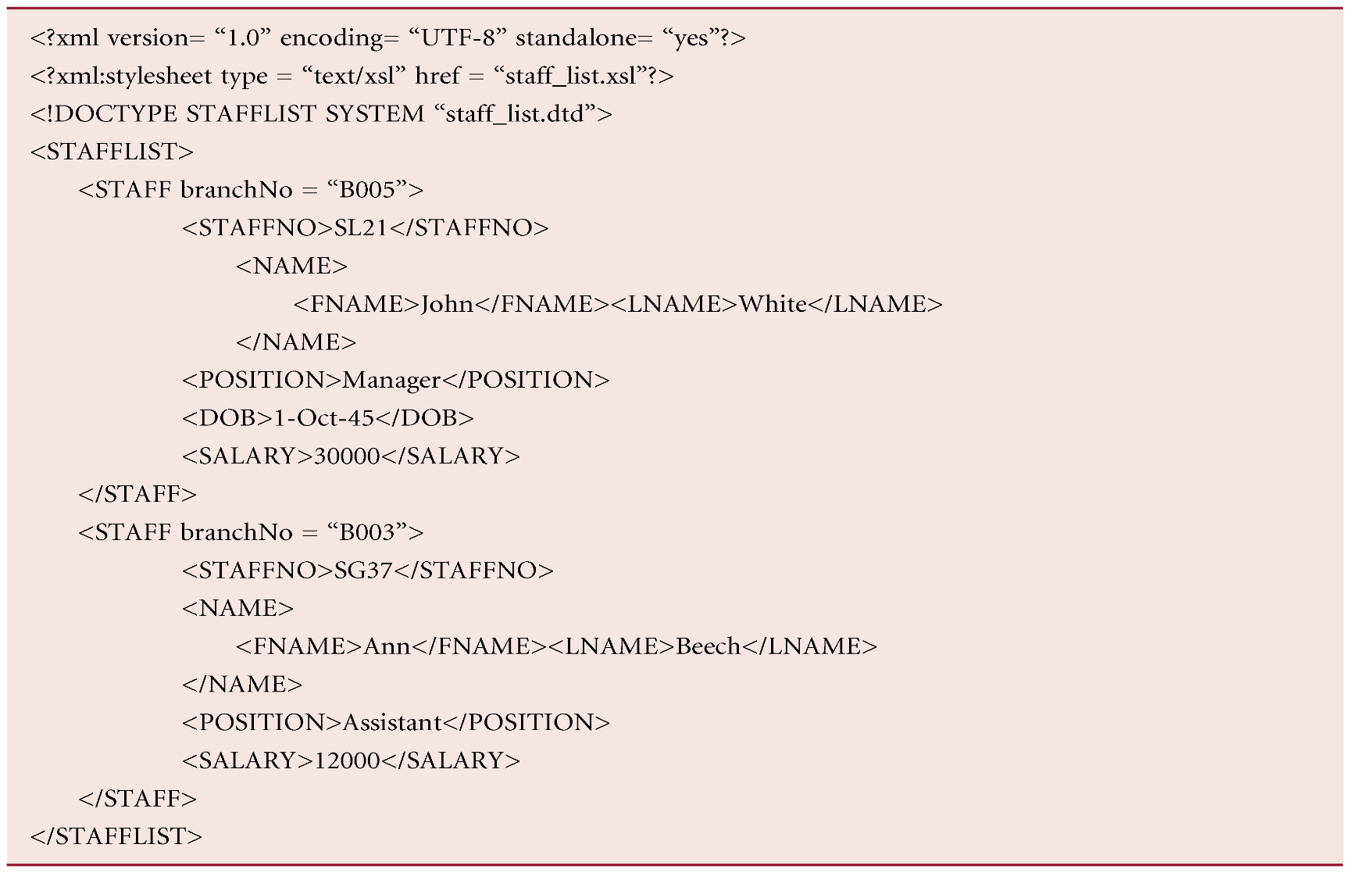
XML Example
Declaration
Definition (DTD)
Root Element
Element
Attribute

Slide 17
XML - Elements
Elements, or tags, are most common form of markup.
First element must be a root element. <STAFFLIST>
Can contain other (sub)elements. <STAFF>
Element begins with start-tag and ends with end-tag. <STAFF> </STAFF>
XML elements are case sensitive
An element can be empty
Elements must be properly nested

Slide 18
XML - Attributes
Attributes are name-value pairs that contain descriptive information about an element.
Less verbose than elements, can have default values
Attribute is placed inside start-tag after corresponding element name with the attribute value enclosed in quotes.
A given attribute may only occur once within a tag, while sub-elements with same tag may be repeated.
Comments: enclosed in <!– and --> tags.
XML Attributes have the following limitations:
Cannot contain multiple values
Cannot contain nesting
Cannot be extended
Further reading: https://www.w3schools.com/xml/xml_attributes.asp
Element vs. Attribute: https://nedbatchelder.com/blog/200412/elements_vs_attributes.html

Slide 19
Where’s the metadata?
“Flat” files – First row often (but not always) has column names
XML files use tags to mark data
JSON, YAML uses key-value pairs

Slide 20
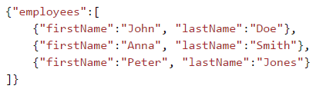
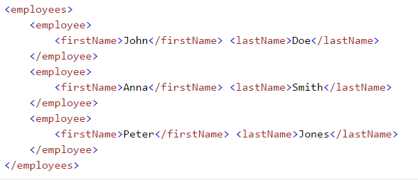
JSON/XML
JSON Example (W3schools):
XML Example (W3Schools):

Slide 21

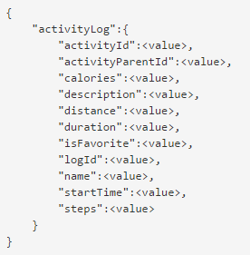
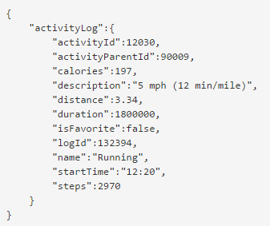
Semi-Structured Data – API FitBit
https://dev.fitbit.com/docs/activity/

Slide 22
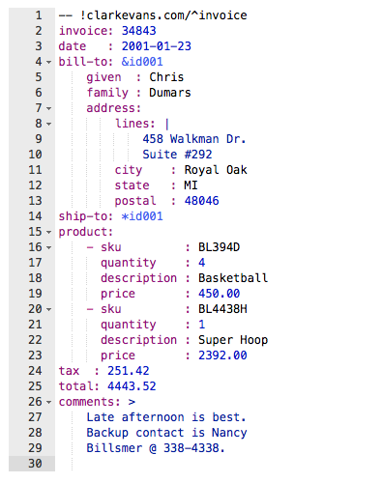
YAML Example

Slide 23
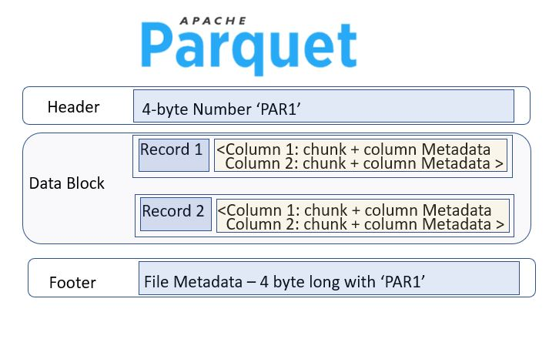
Apache Parquet Files
Open-Source column-oriented data file format designed for efficient data storage and retrieval.
Provides efficient data compression and encoding schemes with enhanced performance to handle complex data in bulk
Supports complex data types and advanced nested data structures.
Good for storing big data of any kind (structured data tables, images, videos, documents).
https://www.databricks.com/glossary/what-is-parquet
https://www.learntospark.com/2020/02/how-to-read-and-write-parquet-in-apache-spark.html

Slide 24
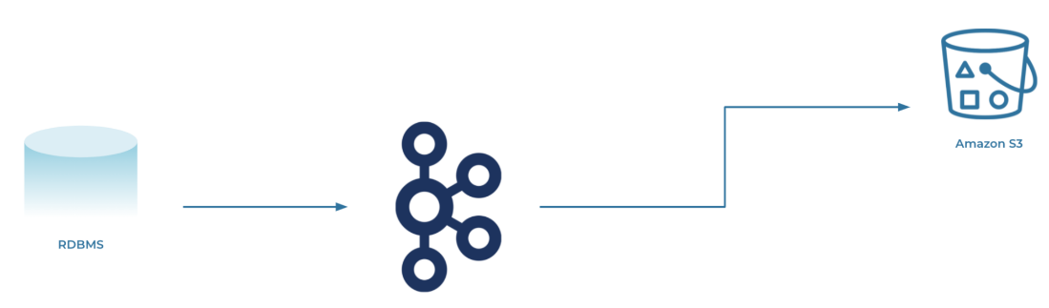
Streaming Data
Continuous flow of data generated by various sources.
Stream processing :data streams can be processed, stored, analyzed, and acted upon as it's generated in real-time.
However - there is no magic it’s just Replication & Transformation
Reacting to data as it changes, while it is current and relevant
Distributed processing - spreading the processing load and avoiding resource shortages from a huge influx of data
NOTE: An interesting Term project challenge is to incorporate steaming data.
S3 Bucket
Kafka
https://www.confluent.io/learn/data-streaming/

Slide 25
Considerations/Tradeoffs
When to pull/extract the data?
Consider down times in transactional systems to minimize lock contention
Source data structure and consistency
Data types/strings, etc
How much scrubbing in transformation phase.
Change data capture
How to make sure that data that has already been processed successfully is not processed again
Accounting for changes in SCDs.
Accounting for changes in structure (XML, JSON, etc
How of ten is data retrieved
Polling
Timeouts

Slide 26
Staging Areas
How can we get the data loaded with minimal effort before processing it?
Can we store a large repository of source data?
Staging Tables
Data in raw source format as close as possible without much transformation
Data Lakes
Central location that holds a large amount of data in its native, raw format.
Uses a flat architecture and object storage (with MetaData) to store the data – consider XML/JSON, etc
Leverage flexible formats, catalog data
Lack of performance and consistency
Further reading – Lake houses!!
https://www.databricks.com/discover/data-lakes/introduction

Slide 27
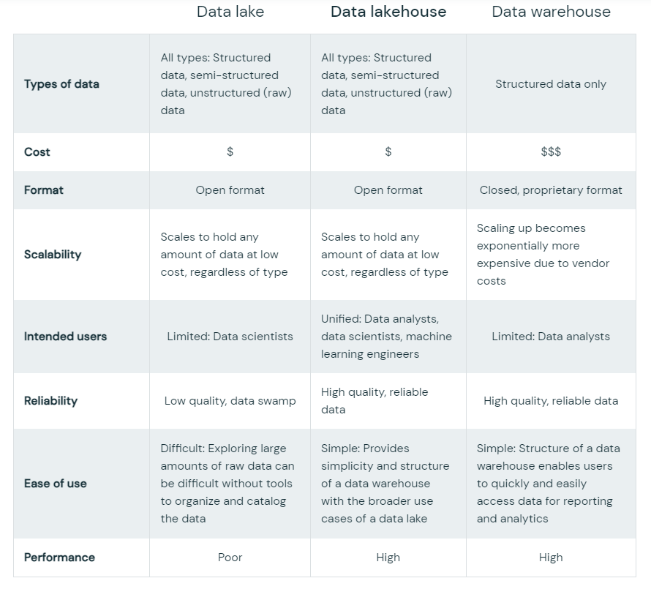

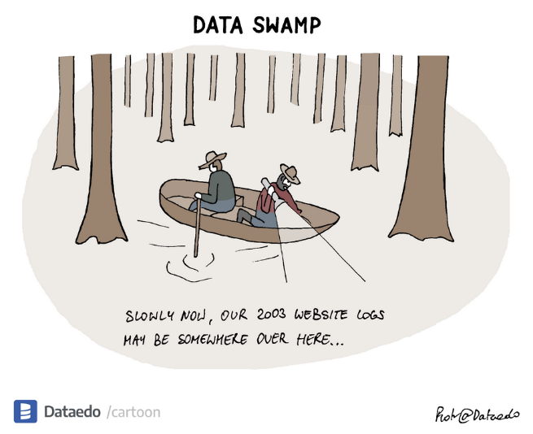
Data Lakes vs. Data Lakehouses vs. data warehouses
https://dataedo.com/cartoon/data-swamp
https://www.databricks.com/discover/data-lakes/introduction

Slide 28

Which brings us to…
Transformation Phase
https://www.teepublic.com/t-shirt/24880902-senior-etl-developer-t-shirt-superpower-gift-item-

Slide 29
Loading directly into SQL vs. Python pre-processing
How can we get the data loaded with minimal effort before processing it?
For RDMS there are GUI tools which allow you to ingest data into tables, and there are command line bulk load options.
Key point: SQL RDBMS requires structure.
When creating staging table in RDBMS, keep to string data types, large varchar length.
Consider which columns you really need if a table has lots of columns, it might be hard to trace the error using one of the ETL tools.
Why might you use Python first:
A bit more forgiving data types, can ingest large files
Consider computer memory limitations on large data frames.
In both instances you might need to create the table in RDBMS first.

Slide 30
Example load from Python into RDBMS
Prep a python data frame with data that you plan to load.
Create table on SQL Server
Establish the connection
Load the data
Check results
Compare number of records loaded
Spot check various records (i.e. strings, etc) - confidence level ~ 5 records

Slide 31
DB connection parameters
DBMS name and version
What language are you using (Python/SQL)
Driver/ODBC specific interface for DBMS
Host name
Database port
database (“instance”) name
User for loading
Should be a separate account from other users

Slide 32
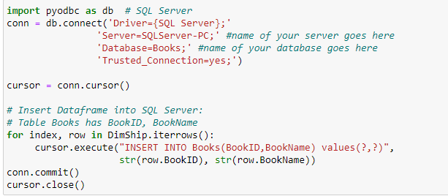
Example Python loading into SQL Server
Note the values (?,?) is SQL Server specific

Slide 33
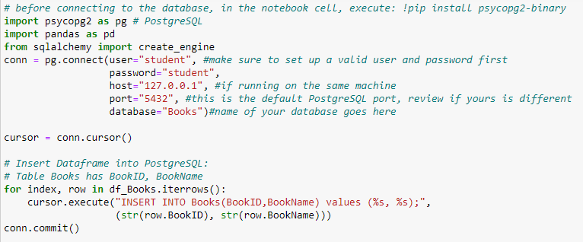
Example Python loading into PostgreSQL
Note the values (%s, %s) is PostgreSQL specific

Slide 34
Transformation Activities
Data Quality Screening
Cleansing/Scrubbing
Deduplication
Simple transforms
Complex transforms
Restructuring
Result: extracted data is in a form matching, or strongly correlated and consistent data to the data warehouse structure conforming to SCDs and Fact tables

Slide 35
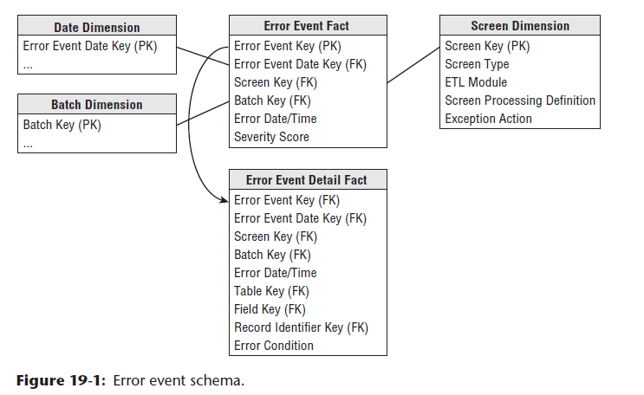
Data Quality Screens
Quality screens act as diagnostic filters in the data flow pipelines.
Quality screens are set up as part of the initial transformational process, and then applied during the automated process for to maintain data quality.
Quality includes column, structure, business rules
During the automated ETL process, if data quality screens are triggered, record issues with data to error tables (dimensions) or halt the process if the threshold is too high.

Slide 36
Data Quality Screens
Column: check for unexpected values, new values, null values, data type inconsistencies.
A set of product sales where products have somewhat inconsistent names, missing names, missing sales price (null), transaction date does not make sense (February 31st)
Structure: check relationship of data across columns – where primary and foreign key match
A sales record for a product that does not actually match any product or customer.
Business Rules: testing that data makes business sense.
A product with cost which makes no business sense (a spoon which costs $1,000,000.00)

Slide 37

Cleansing/Scrubbing
This single slide does not due this process justice
This is the hardest, most time-consuming part!
Why does my job feel like I am a data janitor?
because no one bothered learning normalization!!!
GET YOUR SQL AND PYTHON GOING…..
Checking and correcting data
String parsing functions
Data type conversion
Discarding bad data
Holt the process (and at what threshold)?
Ignore bad records?
Tag and pass the data along?
Applying “audit dimension” – tracks each ETL activity

Slide 38
Deduplication/Consistency
Very common for data extracts to have lots of redundant data
multiple sources often have common records
Duplicate records are acceptable – look to build consistency.
Must establish uniqueness - > “key” fields
If multiple keys disagree, what do you do?
Set up (window) ranking function to choose “best” record, discard the rest (timestamp tiebreaker?)

Slide 39
Simple Transforms
Strigs to Date or date-time
Normalizing Date/Time
Numeric conversions
Location conversions (latitude/longitude – city/state)
Unit conversions, e.g. ounces to grams, currency
Converting via reference tables-converting codes to human-readable descriptions

Slide 40
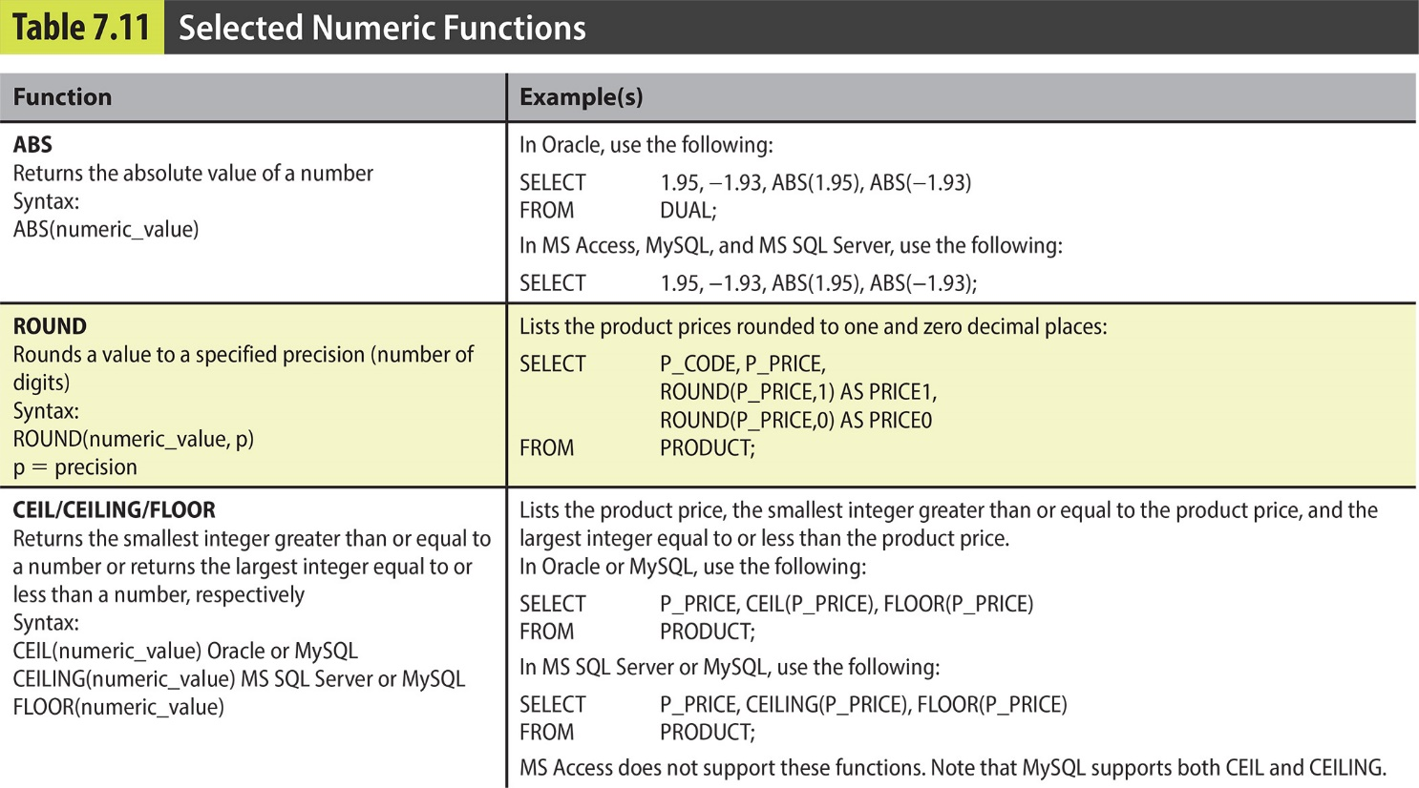
Numeric Functions

Slide 41
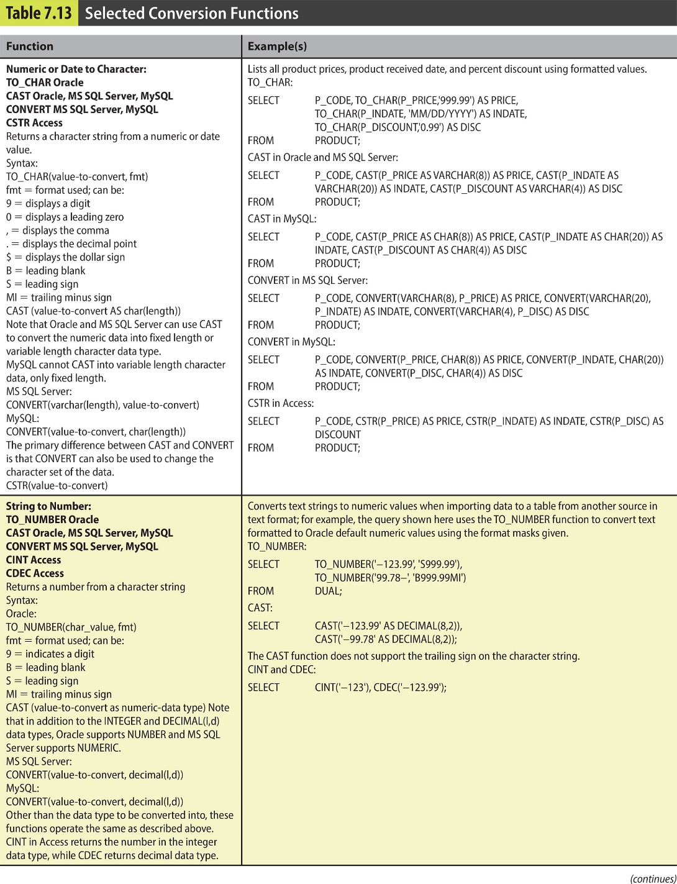
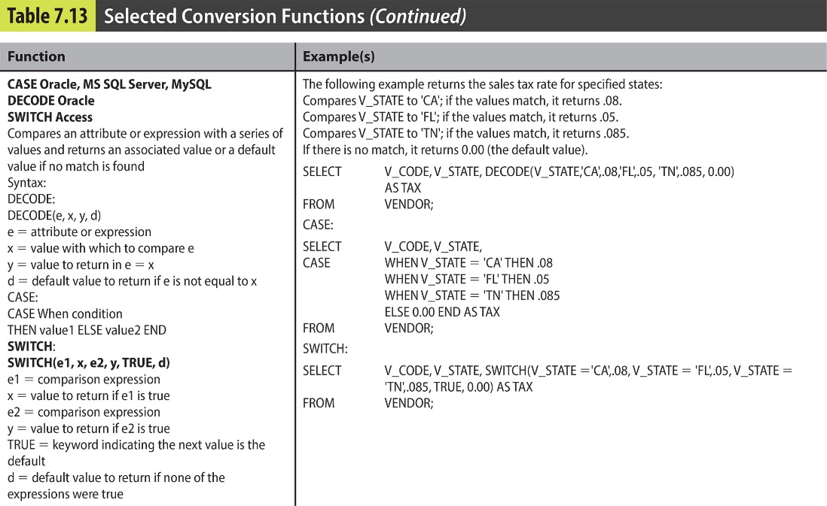
Conversion Functions

Slide 42
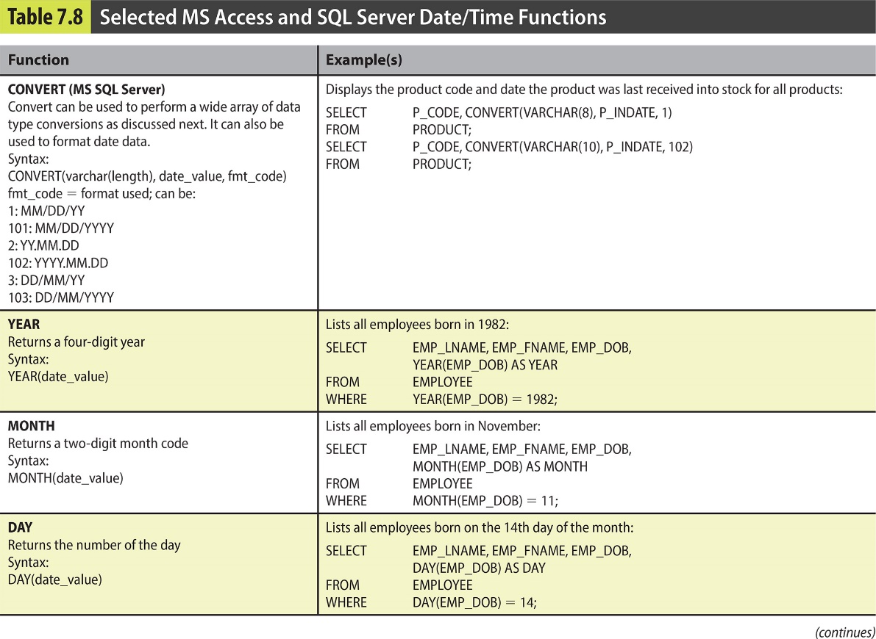
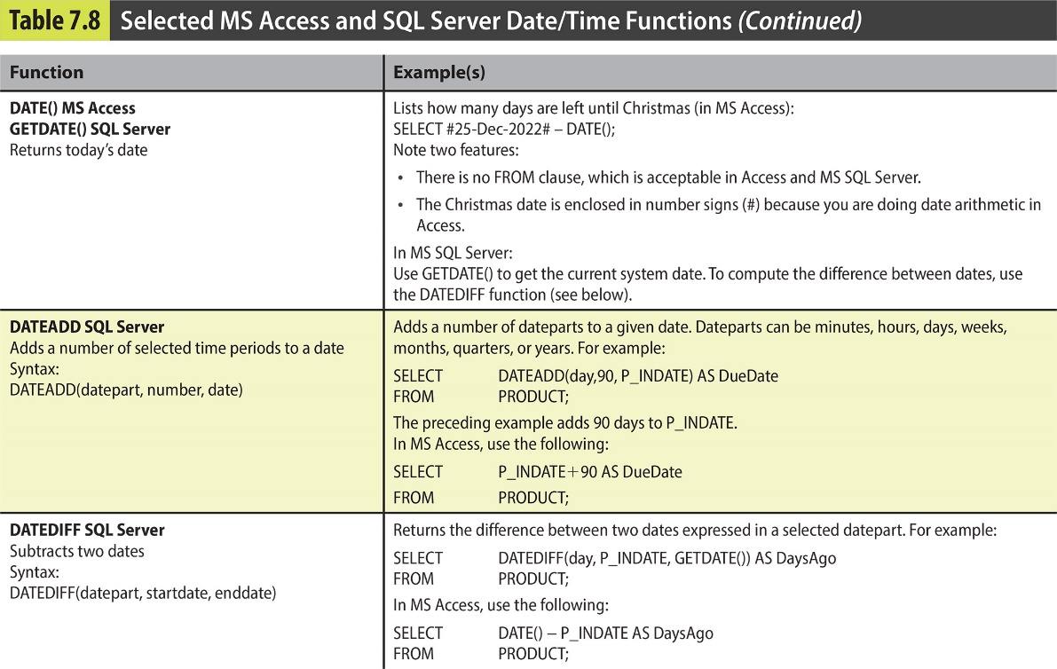
Date & Time Functions

Slide 43
Complex Transforms
String parsing
Substring
Pattern matching
Left/Right/Trim
Nested transformation
Data type conversion used within a larger calculation
For example –calculate Age for the current year for 9/1, first convert string to date (MySQL code below):
DATEDIFF( STR_TO_DATE(CONCAT('9/1/',YEAR(CURRENT_DATE)),'%m/%d/%Y') , STR_TO_DATE([DOB], '%m/%d/%Y'))/365.25
Aggregate computations
Nested sub-queries

Slide 44
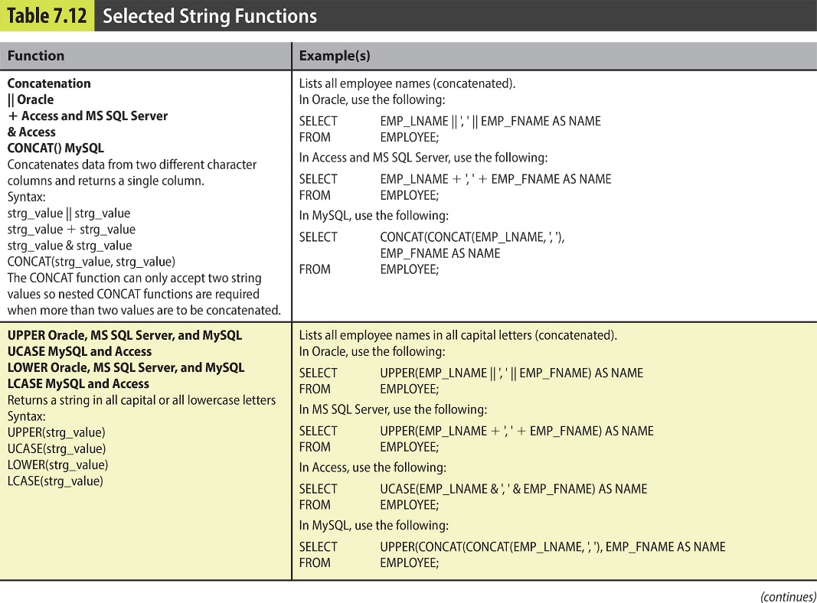
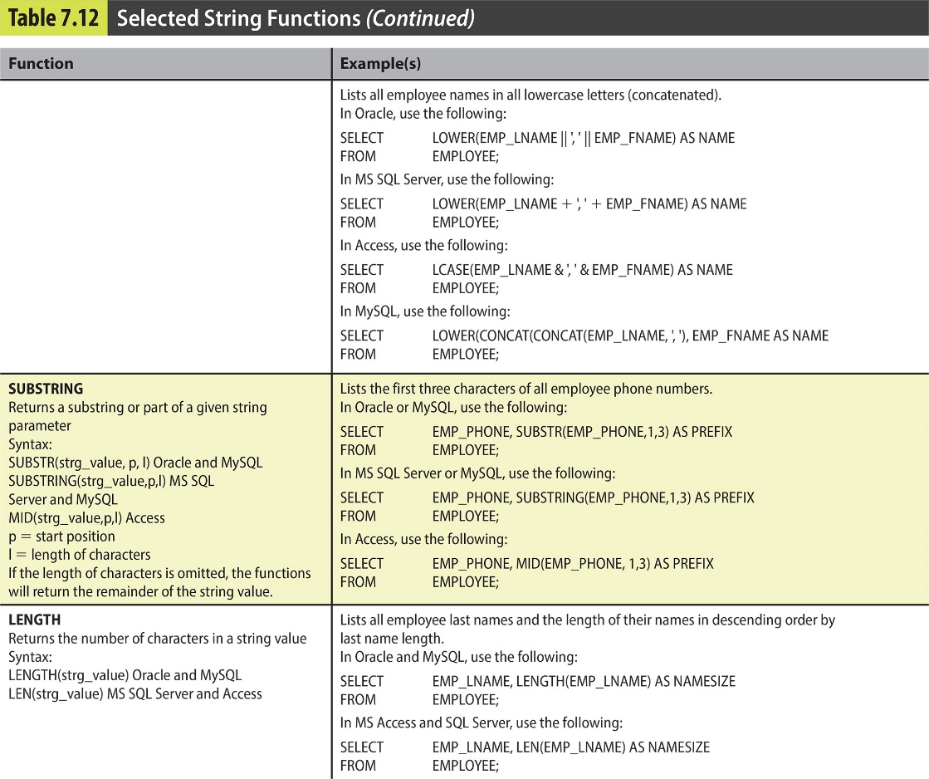
Sting Functions

Slide 45
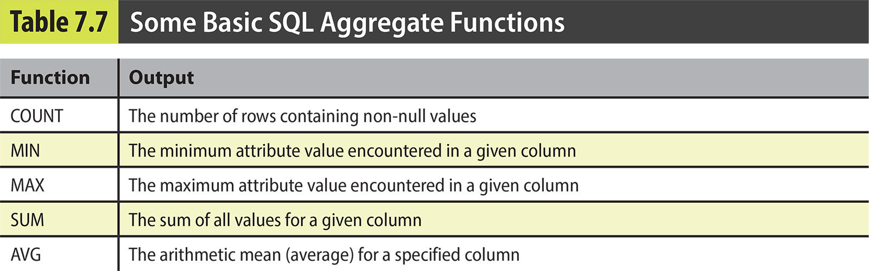
Aggregate Functions in SQL
Summarize information from multiple rows
Built-in aggregate functions
COUNT, SUM, MAX, MIN, and AVG

Slide 46
Python – Utilizing Pandas
Pandas Python library focuses on data transformation and analysis
Really great functions reference from W3schools:
https://www.w3schools.com/python/pandas/pandas_ref_dataframe.asp
A few examples of functions to consider (df refers to a data frame):
list(df.columns.values) – lists row header of data frame
df.head() lists the headers and sample rows
df.count() Returns the number of not empty cells for each column/row
df.filter(items=[‘Col1', ‘col2', ]) Displaying specific rows
Df.query() Similar to a where clause
df.drop_duplicates() Drops duplicate values from the DataFrame
df['ColumnName'].value_counts() shows top values for unique instances of values in a column,
df.groupby(['ColumnName'] )Groups the rows/columns into specified groups
A join: df.merge(df2, how='left', on=['MatchingField(s) '] indicator=True)
How determines it it’s left, inner, etc, indicator will list the result of the join as a new column
df.explore() converts each element into a row – useful for semi-structured data

Slide 47
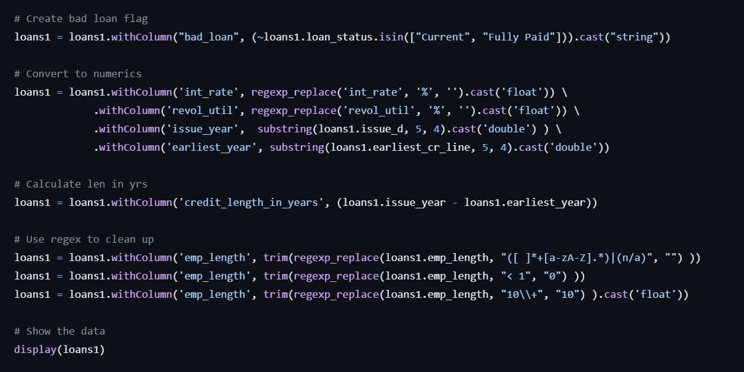
SQL or Python
Python can be more forgiving
However every transform should be it’s own command, otherwise nesting gets a bit messy, and might take more space and memory
https://github.com/JohnMiner3/community-work/blob/master/transition-tsql-skills-to-spark/adb%20code%20samples/03-refining-lending-club-data.py

Slide 48
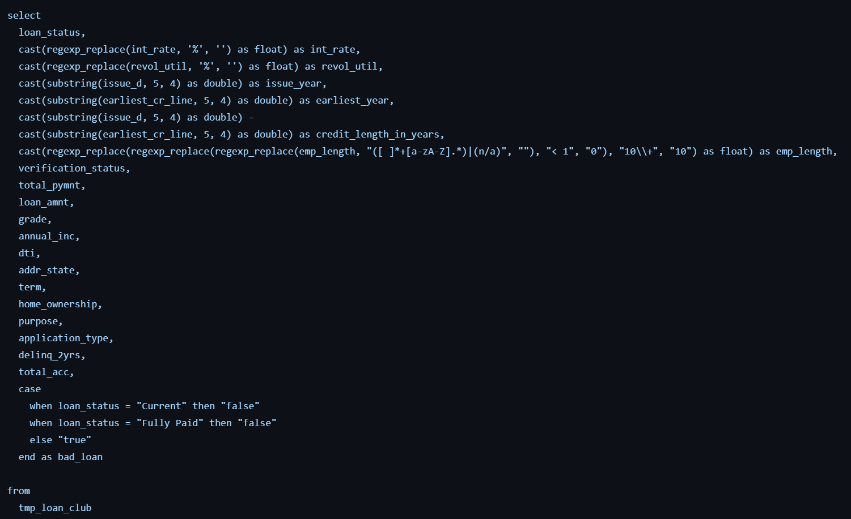
SQL or Python
With SQL you can do the same all at once
https://github.com/JohnMiner3/community-work/blob/master/transition-tsql-skills-to-spark/adb%20code%20samples/03-refining-lending-club-data.py

Slide 49
Restructuring
Multiple data sources may have different structures
Flat
Normalized
Semi-structured
Data Warehouse will have still another structure
Structured- dimensional
Transformation phase
normalize non-1NF data
data type conversions
summarize data
re-map data to alternative structures
apply to dimensional models

Slide 50
Loading Order for Dimensions and Facts
Establish a connection from staging to source dimensional DB (python to SQL or SQL to SQL)
Determine loading sequence from each source.
Load unique values into dimension with generated surrogate dimensional key (initial load)
Link back (a join) to staging table from the new dimension tables on natural attributes to load the fact tables while computing measures.
Subsequent loads need to compare data between staging and dimensions for SCD maintenance.

Slide 51
ETL is NOT a one-time process
Data Warehouse ETL is a repeating process
SCDs drive the process of subsequent loads
Is it a full clear and re-load of the entire data source?
Works well on “smaller” data sets - a few million records is still small!
Works well if dimensional model is not focused on history (SCD1)
Or a flattened model with redundant data.
Is it only the changes since the last load?
Even SCD0 data can accept just changes (i.e. just new records)
Need to determine what has changed since the last load. This is where SCD Load logic comes in.
Consider how to maintain “deleted” data – flag it or discard it
source key for load has not been seen before – this is (usually) a simple insert
previously-loaded source key is not in a new load
source key in load was previously loaded

Slide 52
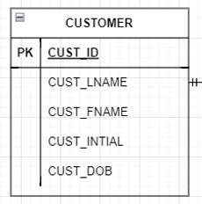
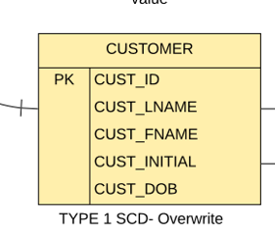
Loading SCD1
Check if record from source exists in dimension
If matching record exists - overwrite dimensional record
If record does not exist add record
In this case no denormalization and or transformation was needed

Slide 53
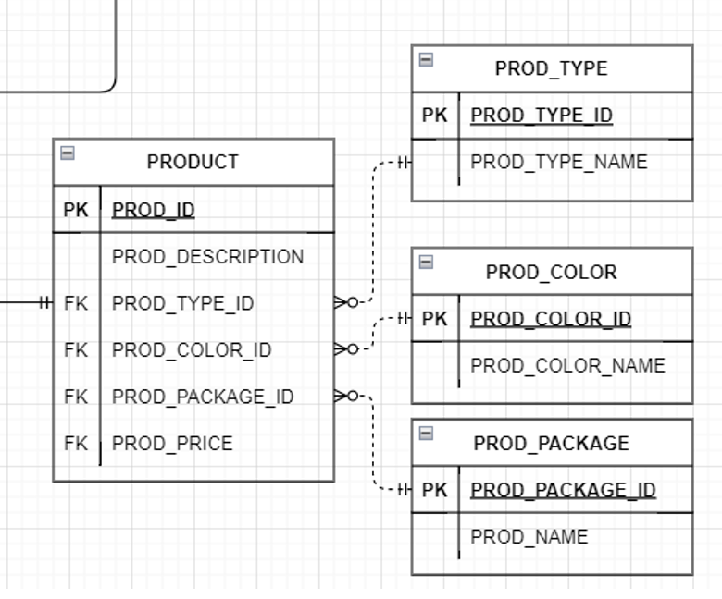
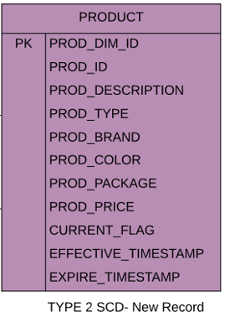
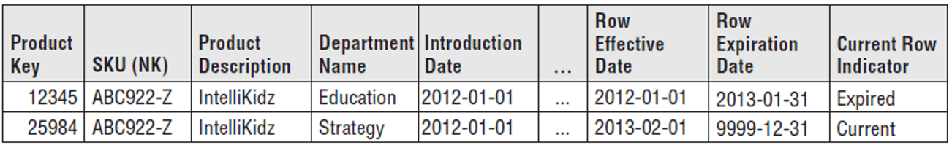
Loading SCD2
Check if record from source exists in dimension
If matching record exists – check if any of the columns have updates in the values
If any columns have different values between source and dimension – add new record, update SCD2 flag/timestamps on current and previous record.
If record does not exist add record with updated SCD2 flag/timestamps setting expire timestamp to future date
Denormalize
& Transform

Slide 54
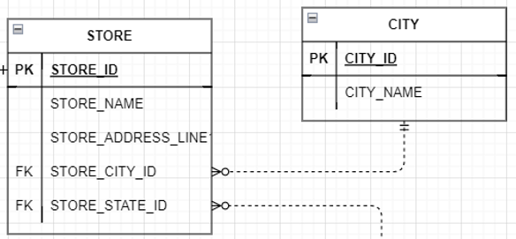
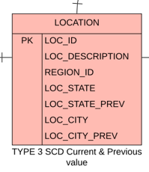
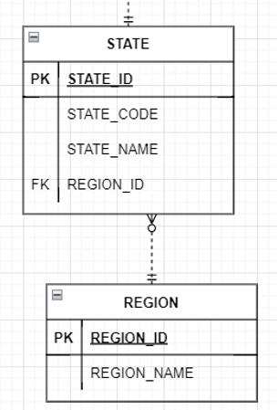
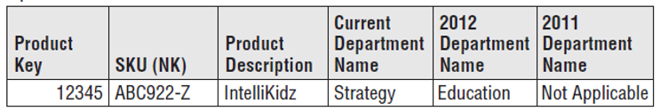
Loading SCD3
Check if record from source exists in dimension
If matching record exists – check if SCD3 columns have updates in the values
If any columns have different values between source and dimension – set the previous value from current field, and new value from the source
If record does not exist add record
Potentially add new columns
Denormalize
& Transform

Slide 55
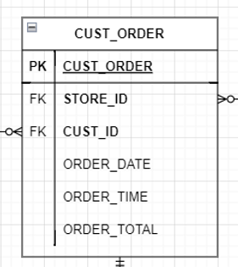
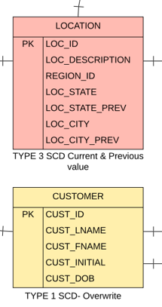
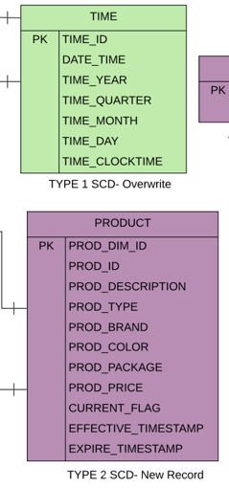
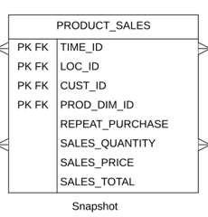

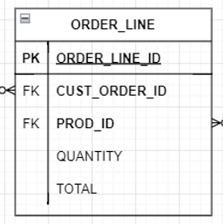
Loading Fact
Join dimensions back to source on the keys (might need to be natural keys)
calculate the measures (aggregate)
Insert Record
Transform
Relational Algebra join symbol

Slide 56
How do we know what has changed
Timestamp from the delta record (may not reliable)
Relational Operational Data Stores:
Log shipping
Replication/mirroring
Checking based on match criteria
checking attributes in dimensions for changes and based on SCD type take appropriate action
SCD0 – always adding
SCD1 – updating/overwriting or adding
SCD2 – always adding, not updating, recording record history
SCD3 - updating/overwriting or adding records – maintain attributes that keep track of historical record.
Fact tables – updating, adding, overwriting (measures)
Don’t forget key management!

Slide 57

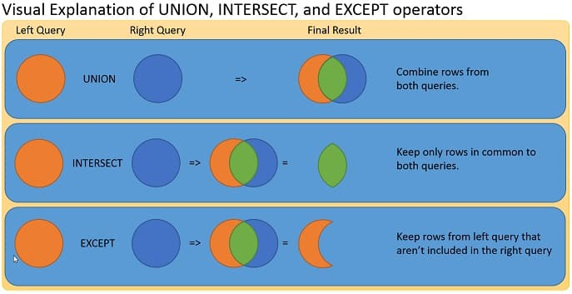
UNION, INTERSECT, EXCEPT
https://277dfx2bm2883ohl6u2g3l59-wpengine.netdna-ssl.com/wp-content/uploads/2014/10/UnionInsersectExcept.jpg

Slide 58
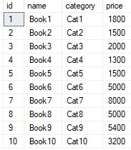
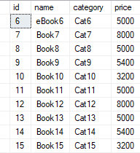
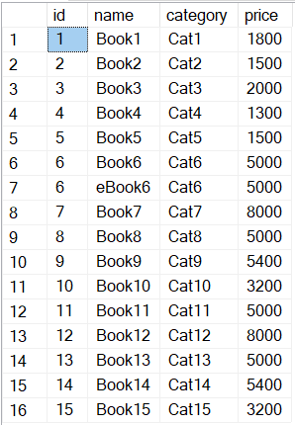


UNION/UNION ALL COMBINE RECORDS FROM TWO QUERIES
This will combine records from both queries and show you unique instances
Union all will not eliminate duplicates between the two record sets
Books1
Books2
UNION
UNION ALL
SELECT id, name, category, price FROM Books1
UNION
SELECT id, name, category, price FROM Books2
SELECT id, name, category, price FROM Books1
UNION ALL
SELECT id, name, category, price FROM Books2
https://www.sqlshack.com/sql-union-overview-usage-and-examples/

Slide 59



EXCEPT THIS WILL FIND ALL THE CHANTES!!
This will find all the changes on any attributes between the first and second query within all attributes – no need for a key match.
Books1
Books2
Books1 except Books2
Books2 except Books1
SELECT id, name, category, price FROM Books2
Except
SELECT id, name, category, price FROM Books1
SELECT id, name, category, price FROM Books1
Except
SELECT id, name, category, price FROM Books2
https://www.sqlshack.com/understanding-the-sql-except-statement-with-examples/

Slide 60


INTERSECT THIS WILL FIND ALL THE MATCHES!!
Combines rows from two queries, returning only the rows that appear in both sets where everything matches in all attributes!
Books1
Books2
Books1 Intersect Books2
SELECT id, name, category, price FROM Books1
Intersect
SELECT id, name, category, price FROM Books2
https://www.sqlshack.com/understanding-the-sql-except-statement-with-examples/

Slide 61




SQL SERVER - MERGE
The MERGE statement compares the source table with the target table based on a key field and then combines Insert/Update/Delete similar to a case statement.
SourceProduct
TargetProduct
-- For Inserts
SourceProduct
TargetProduct
MERGE TargetProducts AS Target
USING SourceProducts AS Source
ON Source.ProductID = Target.ProductID -- NOTE THE KEY MATCH!!
-- For Inserts
WHEN NOT MATCHED BY Target THEN
INSERT (ProductID,ProductName, Price)
VALUES (Source.ProductID,Source.ProductName, Source.Price)
-- For Updates
WHEN MATCHED THEN UPDATE SET
Target.ProductName = Source.ProductName,
Target.Price = Source.Price;
-- For Deletes
WHEN NOT MATCHED BY Source THEN
DELETE;
-- For Updates
SourceProduct
TargetProduct
https://www.sqlshack.com/understanding-the-sql-merge-statement/

Slide 62
POSTGRESQL - UPSERT
The MERGE/UPSERT statement compares the source table with the target table based on a key field and then combines Insert/Update/Delete similar to a case statement.
INSERT INTO customers (name, email)
VALUES('Microsoft','hotline@microsoft.com’)
ON CONFLICT (name)
DO UPDATE SET email
Do Nothing ignores the operation
INSERT INTO customers (name, email)
VALUES('Microsoft','hotline@microsoft.com')
ON CONFLICT (name)
DO NOTHING;
https://www.postgresqltutorial.com/postgresql-tutorial/postgresql-upsert/
PostgreSQL 15 supports Merge!
https://www.crunchydata.com/blog/a-look-at-postgres-15-merge-command-with-examples

Slide 63
Potential Issues with Data Source Keys
The data source controls the creation and assignment of keys
Example: OLTP system assigning CustomerID for customer
One data source may have keys inconsistent with others, or even contradictory
Example: pulling customer data from multiple OLTP systems
Data sources can be out of sync/inconsistent
Example: one source using latitude/longitude another using Zip codes.
We cannot use source-system keys in our data warehouse… unless
Data source uses GUID/OID for keys

Slide 64
Resolve Keys through Surrogates
Surrogate/Synthetic keys should have no meaning – their only attribute is uniqueness
Cannot be derived from source keys in any way – just use a counter/OID/GUID
Surrogate keys cannot repeat for different data sources
Load data into dimensions using surrogate keys
Load data into facts using surrogate dimensional keys
Foreign keys in facts refer to surrogate keys
Can’t load a ‘child’ record without ‘parent’-perform dependency analysis to insert in order
For example: we can’t load a location ID if that location does not yet exist in location dimension.

Slide 65
Key Management
Sequence
Identity
Triggers
Use OIDs and GUIDs (Globally unique identifier)
SQL Server: SELECT NEWID()
PostgreSQL SELECT gen_random_uuid()

Slide 66
Using Sequences
Note: my sequance name is “StudentSeq”
SQL Server:
INSERT INTO STUDENT (STU_NUM,STU_NAME)
select NEXT VALUE FOR StudentSeq, 'Jack’)
PostgreSQL:
INSERT INTO STUDENT (STU_NUM,STU_NAME)
select nextval('StudetSeq') , 'Jack';

Slide 67
DDL Auto-Increment
You can set PK attribute to Auto-Increment at the DDL level (IDENTITY)
SQL Server:
CREATE TABLE STUDENT
(STU_NUM IDENTITY (1,1) PRIMARY KEY,
STU_NAME varchar(255))
PostgreSQL (serial): https://www.postgresqltutorial.com/postgresql-serial/

Slide 68
Load and Verification
Loading – simplicities and complications
Verifying the load
Managing refresh

Slide 69

Managing Load Around DW activity
Communicate with users when loads are taking place and when they are complete
Load off hours to avoid inserts vs. reads
Extra-large transactions on load
Allocate extra storage to account for large rollback segments (recall transaction logs)
Versioning approach- Mark data with Load ID
Rebuild indexes after load
Create notification reports/emails with errors so that you can review status and errors in the morning
Example data load status email from Clever.com
Notes:
Kimball calls load ID “audit key”

Slide 70
Load Errors table/reports
Record individual errors during load
Captures any anomalies transformation and or load logic didn’t account for.
Identify source file(s) or data for error
Type of error
Any possible description
Look to build robustness within the transformation and loading process, a few errors should not break the entire load.

Slide 71
Verification
Review counts of records loaded, ignored etc
You should have a sense of how much data is loaded daily.
Did all the records in the source get loaded?
Can you account for all the records that did not load? Are these needed?
Did failures in one load stream impact/propagate into other streams?
Implement tables that track ETL processes (audit tables) and failures (error tables) for compliance and debugging.
Implement tables to track lineage (what the original data source was) and dependencies (what tables are related) in order to track down bad data and update related tables.
Do you need to clear and repeat this load with ETL fixes or data source corrections?

Slide 72
Data Flows Visualize the ETL process
Why do we model:
To understand complexity
Break down complex components into smaller understandable parts
To communicate and document our design and process
To see the big picture and identify what we might have missed!
Data flow diagram (DFD) – a process model used to depict the flow of data through a system and the work or processing performed by the system. (Whitten, 2007)
Logical model – focus on the logical processes
Physical model – focus on the physical components performing the logical process

Slide 73


Components of a Data flow
External Actor: A person or another system outside the scope of the system modeled.
Depicted by a square or rectangle
Define the “boundary” or scope of a system being modeled.
Work & activities may occur inside the external agent, but out of scope of what’s being modeled.
As scope changes, external agents can become processes, and vice versa.
Permissible to duplicate (Whitten 2007), should be at the edges of DFDs and should be minimized.
Process performed by a component of the system in response to incoming data flows or conditions. (Whitten, 2007)
Depicted by oval, circle or rounded rectangle
Logical dataflow: represents a logical process such as a specific Extract, transform or load component.
Physical dataflow: represents a component which performs Extract, transform or load process or multiple processes.

Slide 74



Components of a Data flow
Data Store Stored data intended for later use, such as file, table, database or data frame
Depicted by data store label with line above and below, or data store symbol
A data store is “data at rest” compared to a data flow that is “data in motion.” (Whitten, 2007)
Permissible to duplicate (Whitten 2007), should be at the edges of DFDs and should be minimized.
Data flow: Data that is input to or output from a process. (Whitten, 2007).
A data flow is data in motion
Label represents data sent
Data flows connect external agents, processes, and data stores
A data flow may also be used to represent the creation, reading, deletion, or updating of data in a file, database or a data frame

Slide 75

Illegal Data Flows
Figure 9-9 P330 (Whitten, 2007)

Slide 76


Logical compliments Physical
Logical model – focus on the logical processes
Physical model – focus on the physical components performing the most important logical processes
Notice in the above example the SCD1 maintenance is missing and should be added in the process

Slide 77
What should an ETL tool manage Both off-Shelf or custom built
Structure and usage of each data source
Extraction/Transmission mechanisms
Location of incoming feed directories
Structure of the destination data warehouse
Rules for cleansing and deduping
Rules or stipulations for scheduling
Credentials for data sources
Usernames for systems, with passwords or encryption keys
Host names and service ports

Slide 78
Kimball's checklist before launching the ETL design and development effort
Business Needs
Helps decide on data choices, transformations
Compliance
Legal and reporting compliance
Availability in sources of data, or how data is handled
For example – Google Data Studio does not yet comply with FIRPA
Data Quality
How data will impact business, care and handling, distribution
Security
Access controls and data privacy
Data Integration
Data Latency
How quickly can the data be loaded before it’s no longer useful
Archiving and Lineage
Works with compliance
BI Delivery Interfaces
Legacy Licenses
(beginning of chapter 19)

Slide 79
References
BU MET CS689 Module 3.
Kimball, Ralph, and Margy Ross. The Data Warehouse Toolkit: The Definitive Guide to Dimensional Modeling. John Wiley Sons, 2013.
Krishnan, K. (2013). Data warehousing in the age of big data. Morgan Kaufmann.
Whitten, B. (2007). Systems analysis & design methods. (7th ed.). New York, NY: McGraw-Hill Irwin.
Coronel, Morris, Rob (2013). Database Systems: Design, Implementation & Management. Ninth Edition. Boston: Cengage Learning
W3Schools
www.sqlshack.com
Miner, John (2023) https://github.com/JohnMiner3/community-work/blob/master/transition-tsql-skills-to-spark/adb%20code%20samples/03-refining-lending-club-data.py

